Slide 1
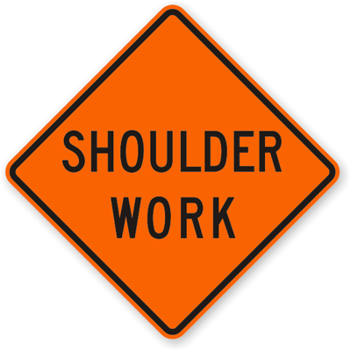
Total Shoulder Arthroplasty
Betsy M. Nolan, MD
July 26, 2016

Slide 2
Total Shoulder Arthroplasty
History
Indications
Technique
Reverse TSA
Rehabilitation

Slide 3
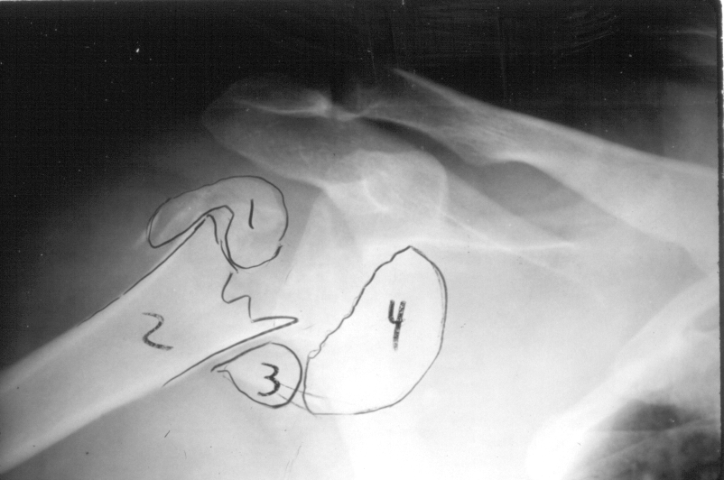
Diagnoses
Osteoarthritis
Rheumatoid Arthritis
Avascular Necrosis
Posttraumatic Arthritis
Capsulorrhaphy Arthropathy
Cuff Tear Arthropathy
Some proximal humerus fractures
Revision

Slide 4
Shoulder Arthritis-Nonoperative Rx
Rest
NSAIDs
Moist heat
Gentle therapy
Activity modification
Cortisone injection
Joint lubricants (Synvisc, Hyalgan)
Not FDA approved for shoulder
$750 out of pocket

Slide 5
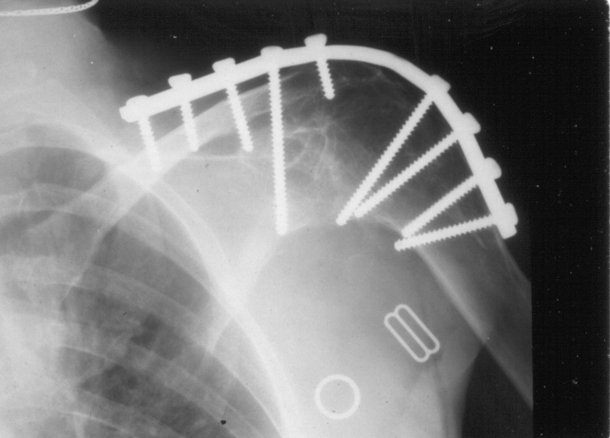
Shoulder Arthritis-Surgical Options
Arthroscopic debridement
Interposition arthroplasty
Resection arthroplasty
Prosthetic arthroplasty
Conventional TSA
Reverse (inverse) TSA
Arthrodesis

Slide 6
Arthroscopic Debridement
Good option for early arthritis and young patient
Temporizing measure
Low morbidity
Good pain relief
Weinstein DM, Arthroscopy, 2000
Failure with chondral lesions >2cm
Cameron BD, JSES, 2002

Slide 7
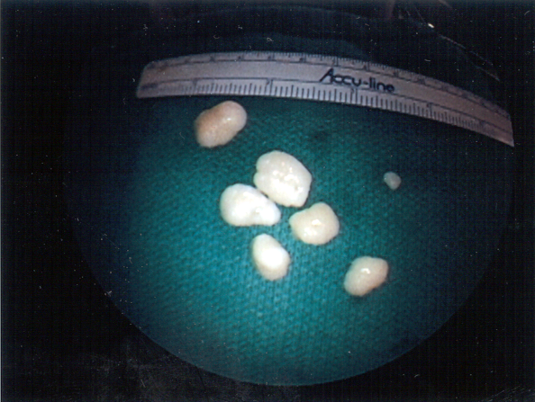
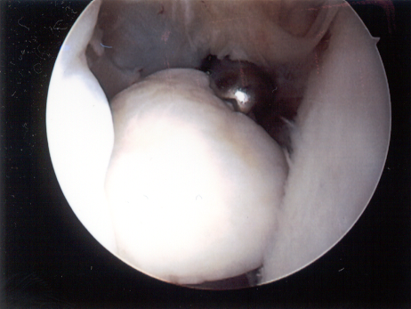
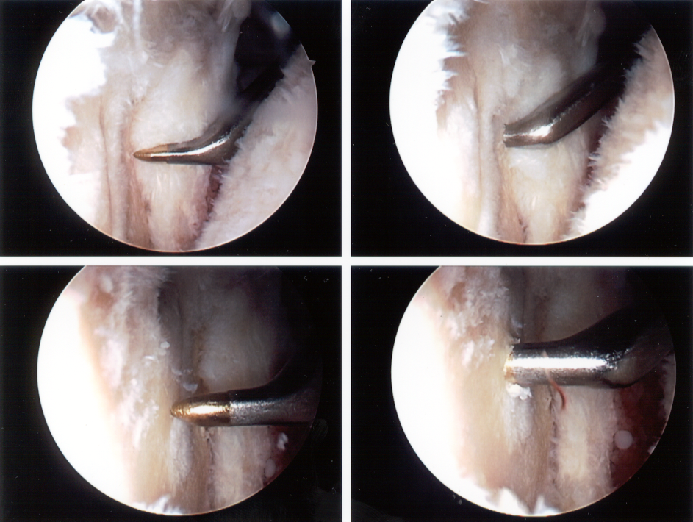
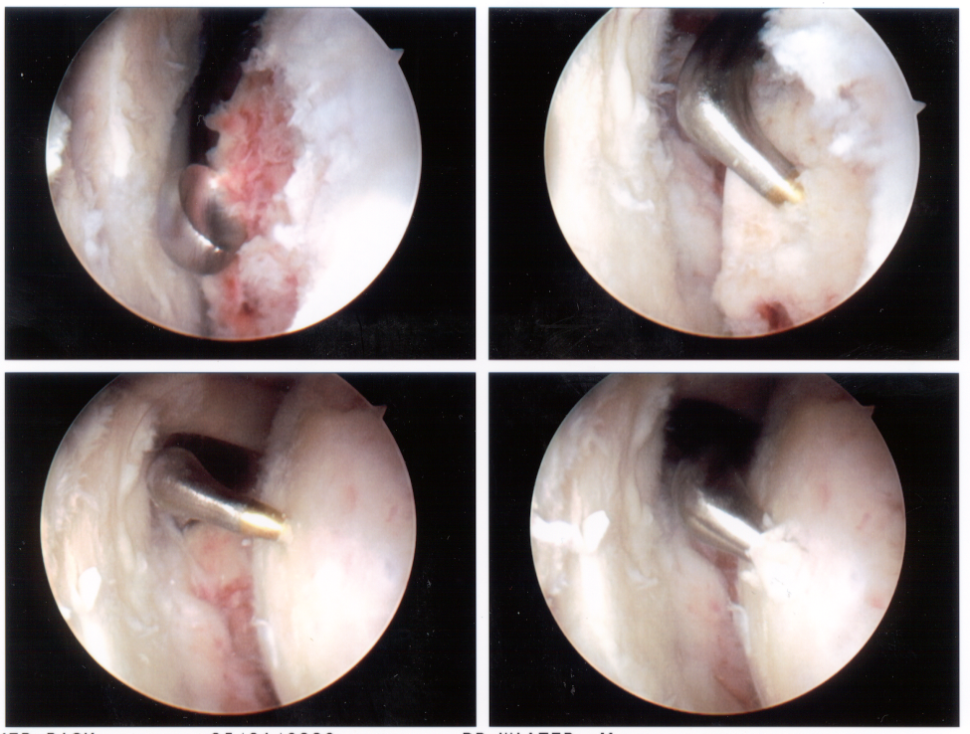
Arthroscopic Debridement-Technique
Removal of loose bodies
Synovectomy
Debridement
Capsular release
Chondroplasty
Microfracture
+/- acromioplasty

Slide 8
Resection Arthroplasty
Pain relief possible
BUT function and ROM poor as glenohumeral fulcrum lost
aFE 40-90°
Cofield RH, Instr Course Lect, 1985
Historical interest
Neer CS, Am J Surg, 1953

Slide 9
Shoulder Arthroplasty
Shoulder arthroplasty = Shoulder replacement
BUT not all are “total shoulders”
Total shoulder arthroplasty (TSA)
Replace humeral head and glenoid
Shoulder hemiarthroplasty (HHR)
Humeral head replacement
Replace only humeral head

Slide 10
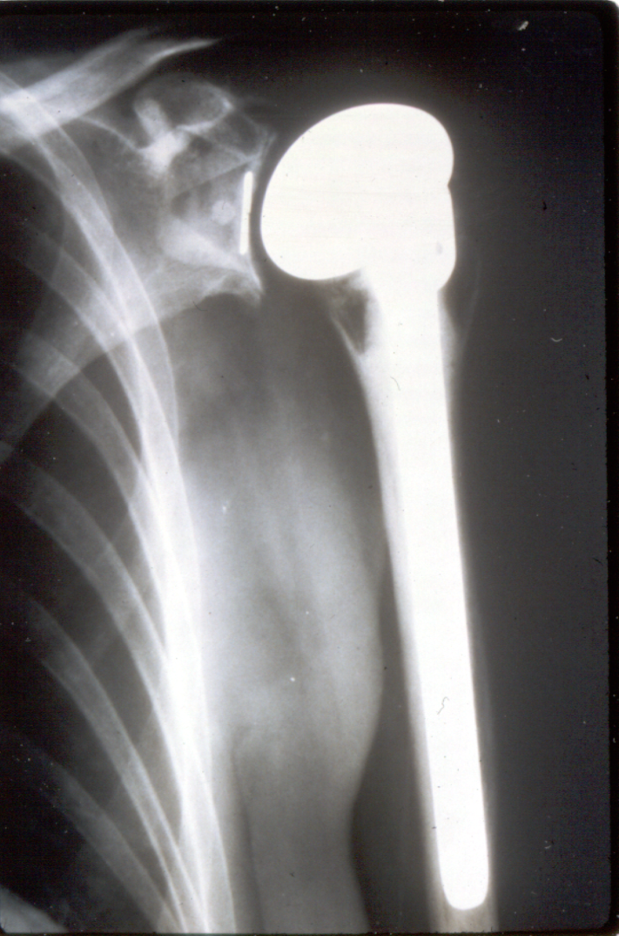
Shoulder Arthroplasty
53,ooo shoulder arthroplasties per year
>90% satisfactory rate
Revision rate 0-17%

Slide 11
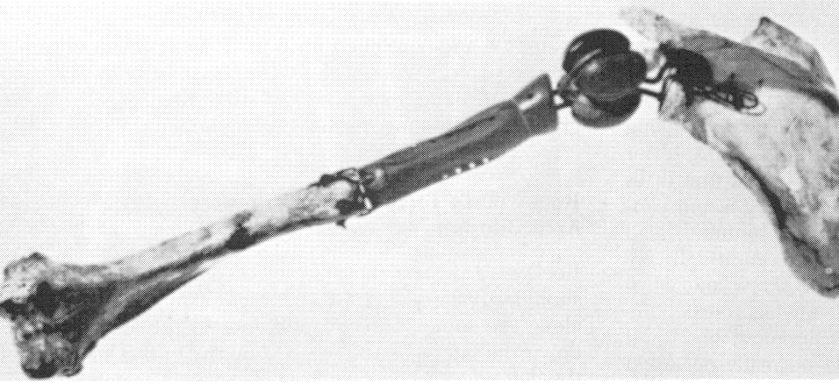
Shoulder Arthroplasty
Historical review
1893 French surgeon Péan
First prosthetic shoulder replacement
Platinum and rubber
Implanted for tuberculous arthritis
Removed 2 years later

Slide 12
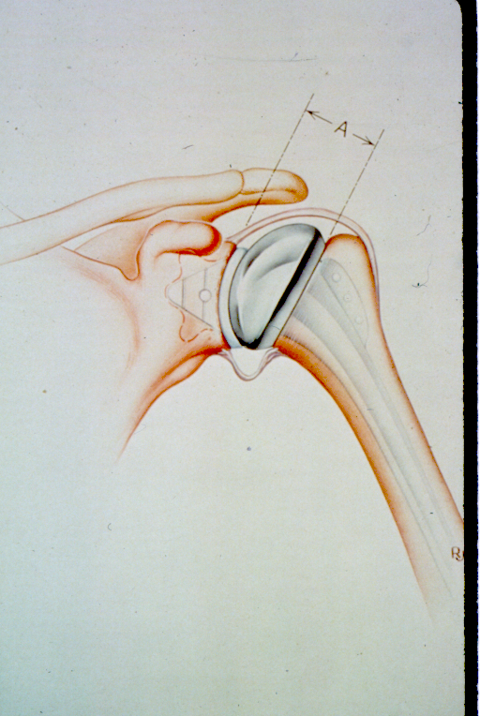
Shoulder Arthroplasty
1950 Hemiarthroplasty
1970 Fixed fulcrum fully constrained
1974 Total Shoulder Arthroplasty
Conforming surface
Minimally constrained

Slide 13
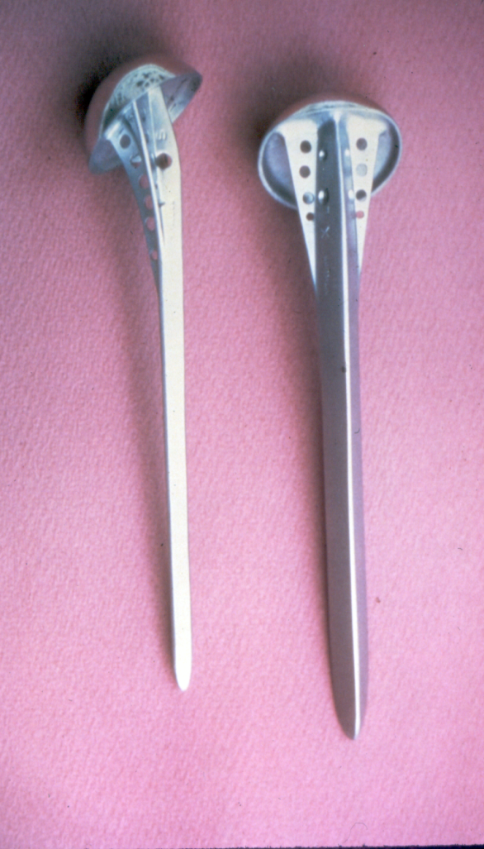
Shoulder Arthroplasty Neer I Hemiarthroplasty
Initially for fractures
Results for DJD satisfactory
Neer CS II, JBJS-A, 1955

Slide 14
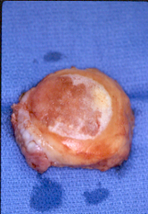
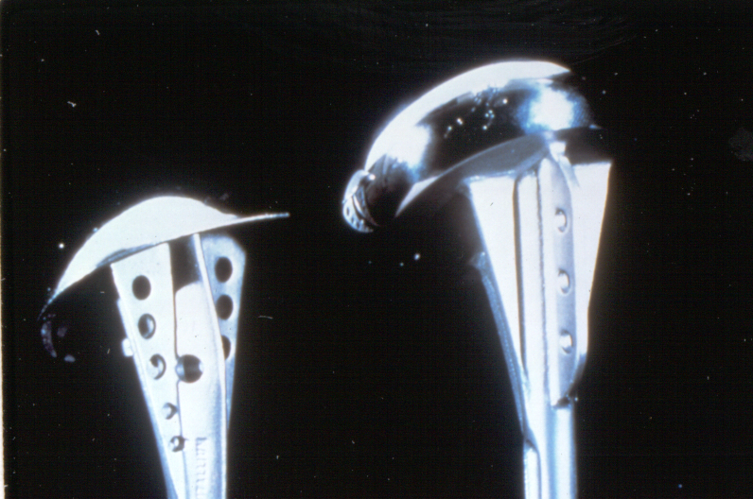
Neer I Hemiarthroplasty 46 shoulders OA
Excellent 20 43.5%
Satisfactory 20 43.5%
Unsatisfactory 6 13.0%
Neer CS II, JBJS-A, 1974

Slide 15
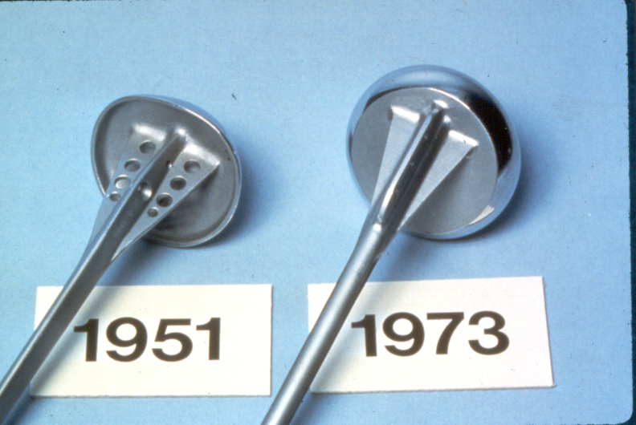
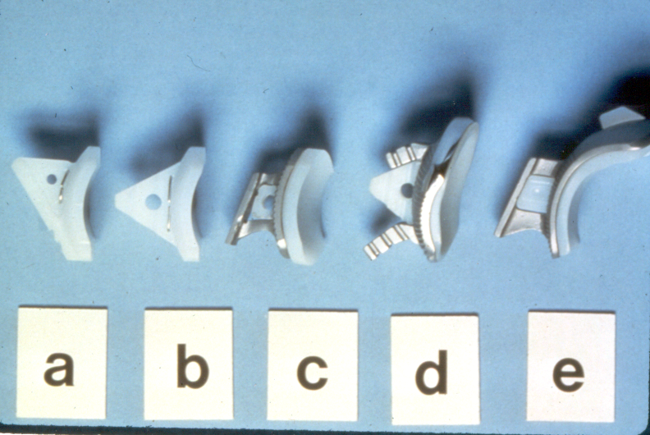
Shoulder Arthroplasty Neer II

Slide 16
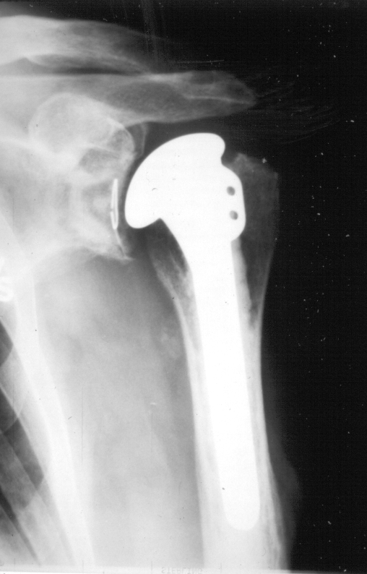
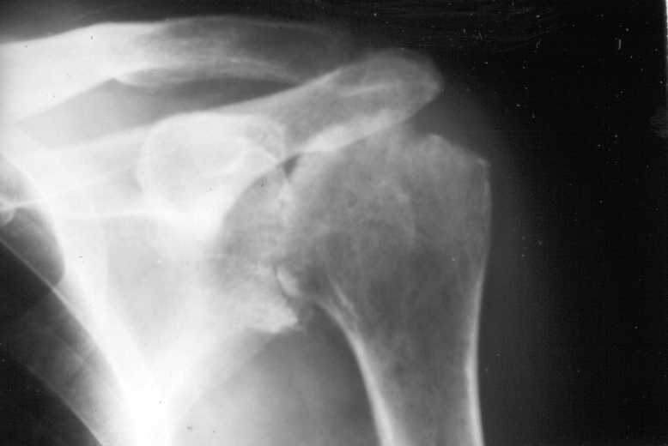
Shoulder Arthroplasty Minimally Constrained Design
First generation 1970’s
Conforming one-piece metal humeral head with UHMWPE glenoid component
Stability dependent upon soft tissues

Slide 17
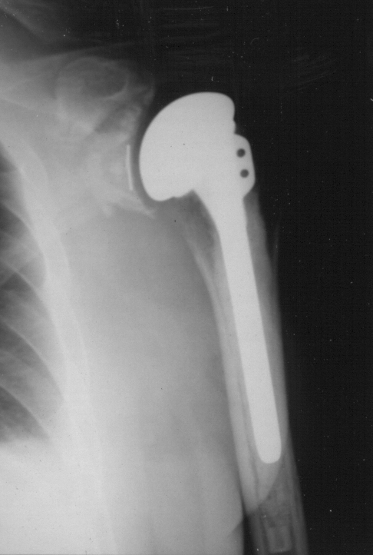
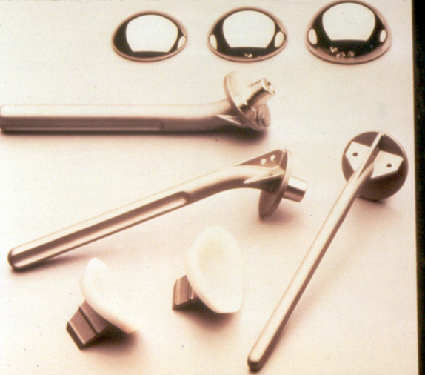
Shoulder Arthroplasty
Second generation 1980’s
Modular head
Greater flexibility

Slide 18
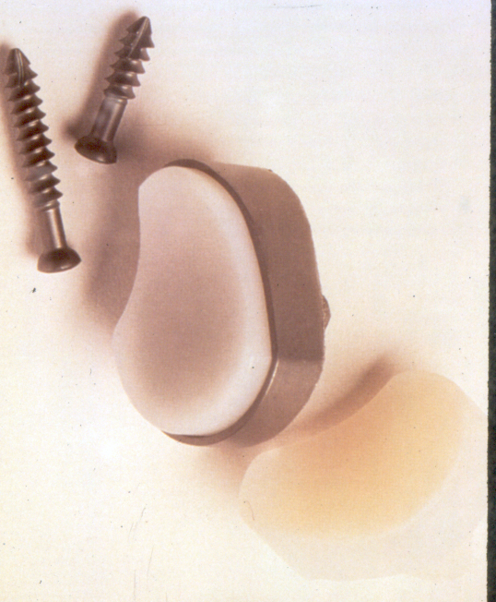
Shoulder Arthroplasty
Glenoid designs
Cemented vs porous-ingrowth
All-poly vs metal-backed
Keels vs pegs
Gold standard
Cemented
All-poly
Peg

Slide 19
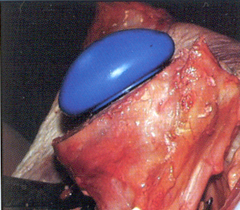
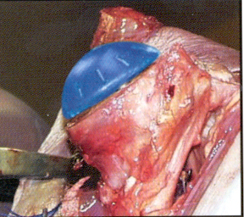
Third Generation 1990’s
More anatomic design
Offset humeral heads
Variable neck-shaft angle
Variable glenoid conformity

Slide 20
Shoulder Arthroplasty Surgical Indications
Shoulder pain and stiffness
Failed conservative treatment
Active lifestyle
GH arthritis
Radiographs

Slide 21
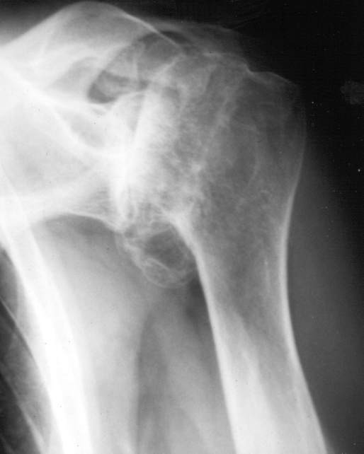
Shoulder Arthroplasty Primary Osteoarthritis
Most common indication
Joint surface incongruity
Posterior glenoid wear
Soft tissues preserved
Deltoid intact
Capsule + cuff contracted

Slide 22
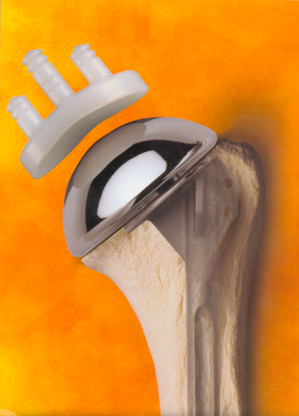
Modern Prosthetic Design
Expanded size range
Increased neck-shaft angle
Improved abduction
Less medialization
Variable glenoid conformity
Standard and offset heads
Precise instrumentation and retractors

Slide 23
Shoulder Arthroplasty Surgical Technique
Interscalene regional anesthesia
Beach chair position
Deltopectoral approach
Subscapularis release
Proper implant selection
Soft tissue balancing

Slide 24
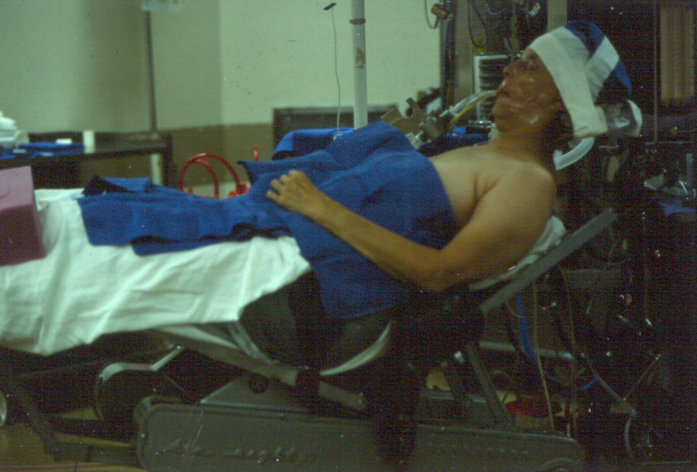
Shoulder Arthroplasty Surgical Technique
Beach chair position

Slide 25
Shoulder Arthroplasty Surgical Technique
Arm positioner
Spider
McConnell

Slide 26
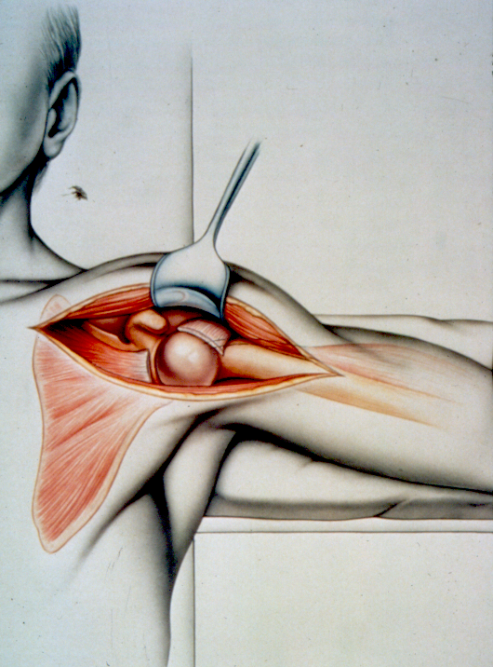
Shoulder Arthroplasty Surgical Technique
Deltopectoral approach

Slide 27
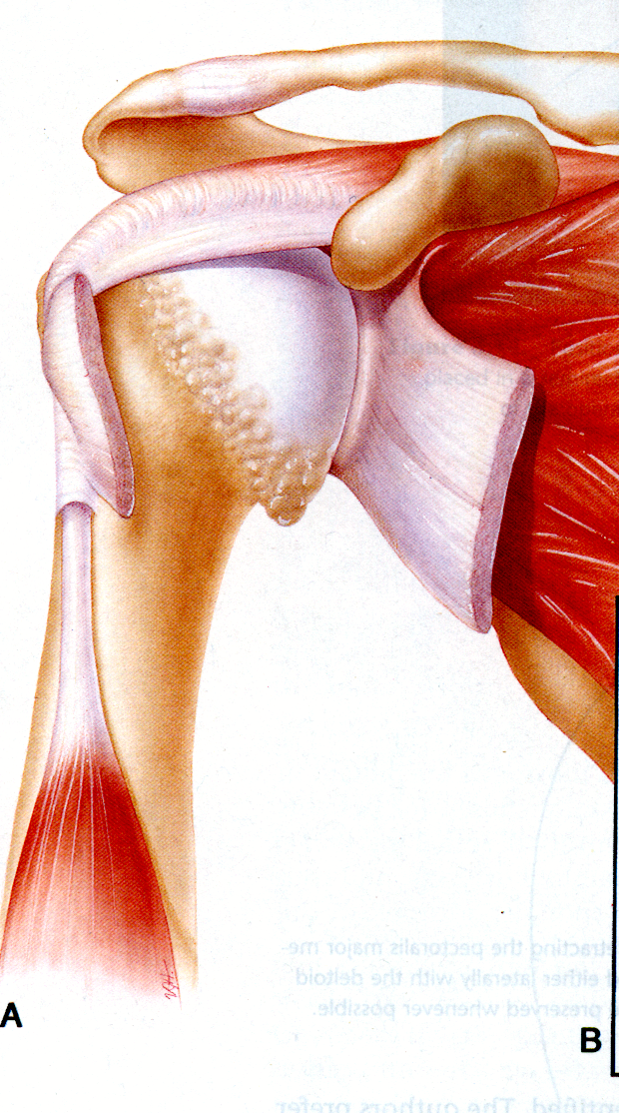
Shoulder Arthroplasty Surgical Technique
Subscapularis release

Slide 28
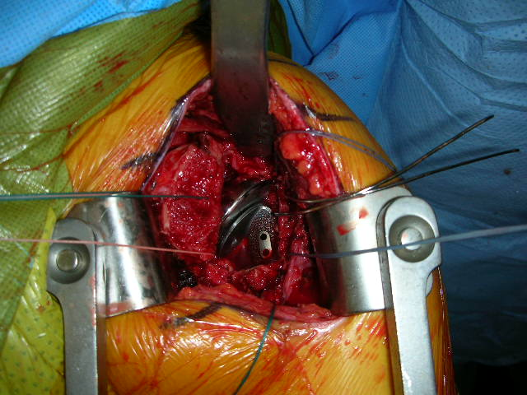
Primary Osteoarthritis 68 yo male
Lesser tuberosity osteotomy

Slide 29
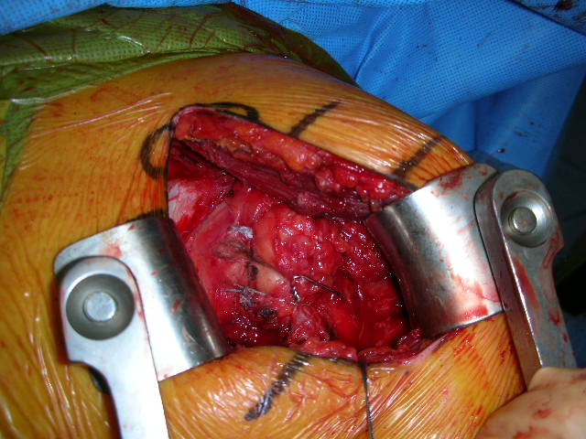
Primary Osteoarthritis 68 yo male
Lesser tuberosity osteotomy
Repair with two #2 Fiber wire sutures
One 18 g wire

Slide 30
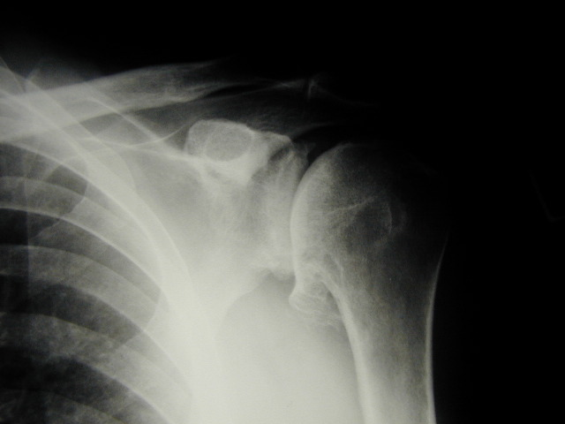
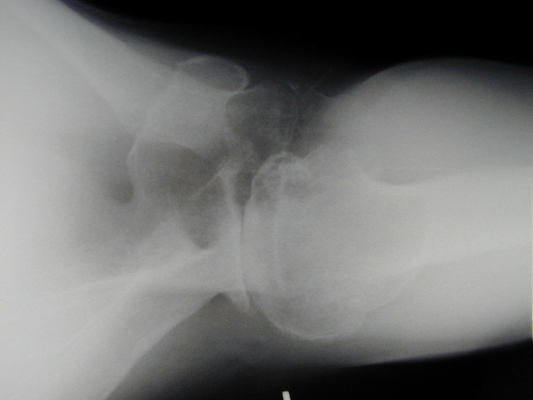
Primary Osteoarthritis 68 yo male
Pre op

Slide 31
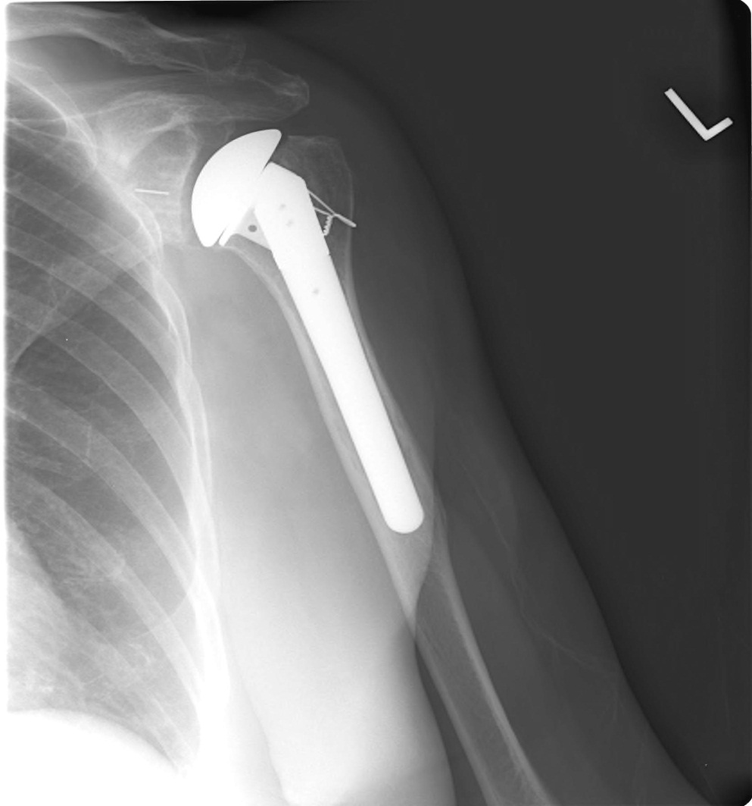
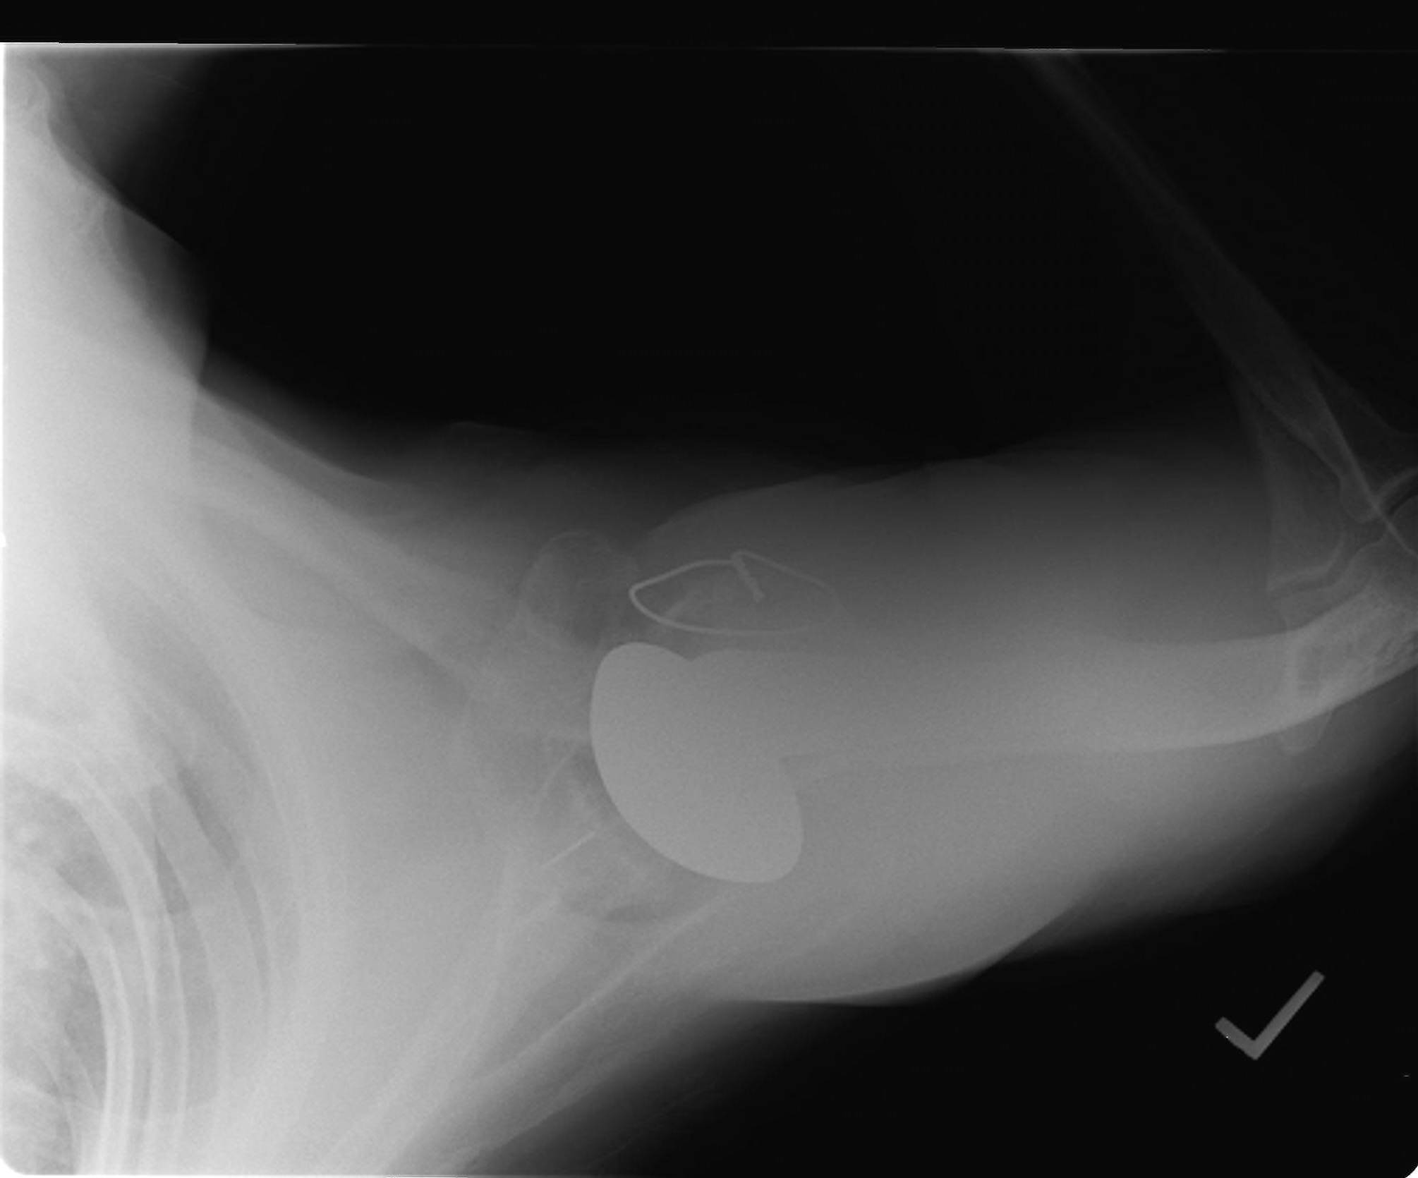
Primary Osteoarthritis 68 yo male
Post op

Slide 32
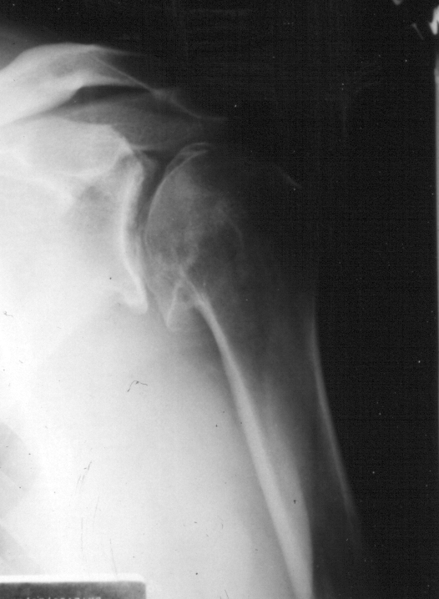
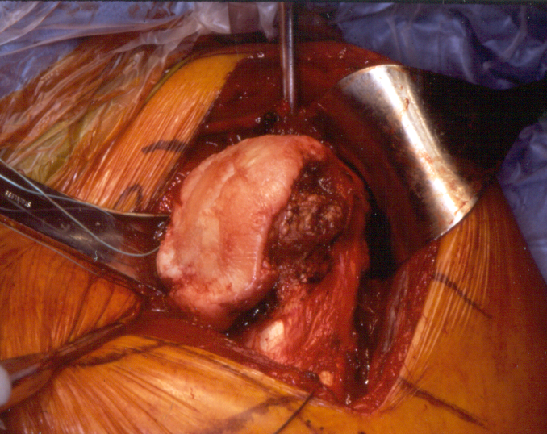
Shoulder Arthroplasty Surgical Technique

Slide 33
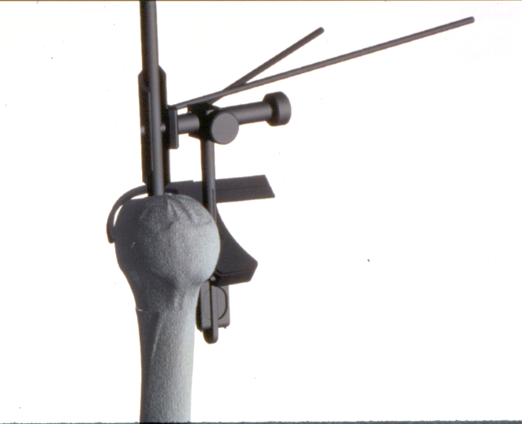
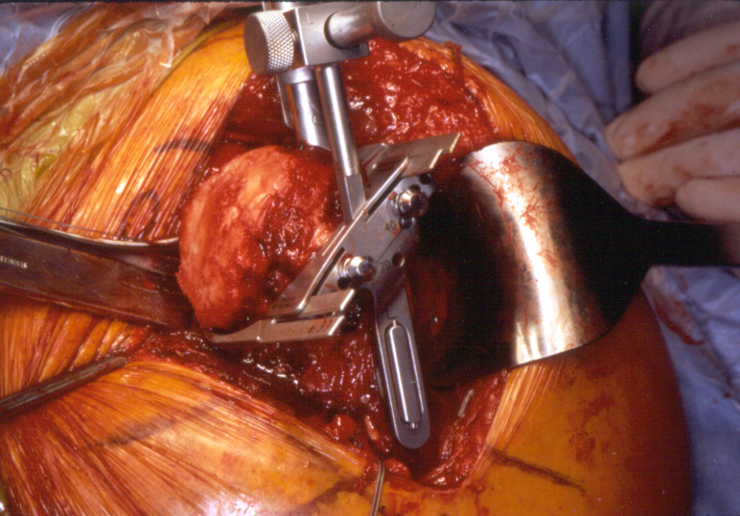
Shoulder Arthroplasty Surgical Technique

Slide 34
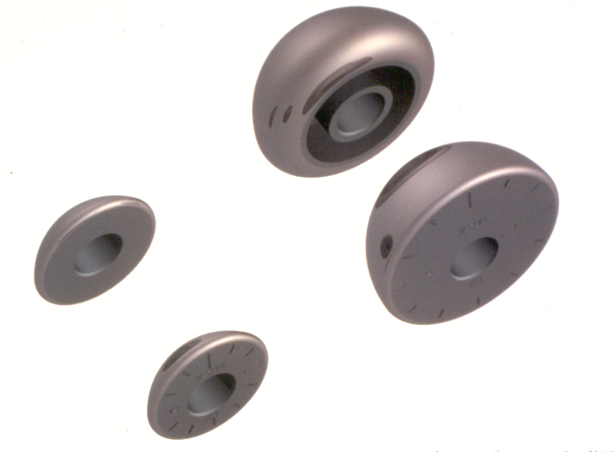
Shoulder Arthroplasty Humeral Head
Modular
Offset and standard option

Slide 35
Shoulder Arthroplasty TSA vs HHA
TSA (glenoid comp)
Glenoid arthrosis
Intact or repairable rotator cuff
Adequate glenoid bone stock
HHA (hemiarthroplasty)
Glenoid not arthritic
Irrepairable RCT
Inadequate glenoid bone stock

Slide 36
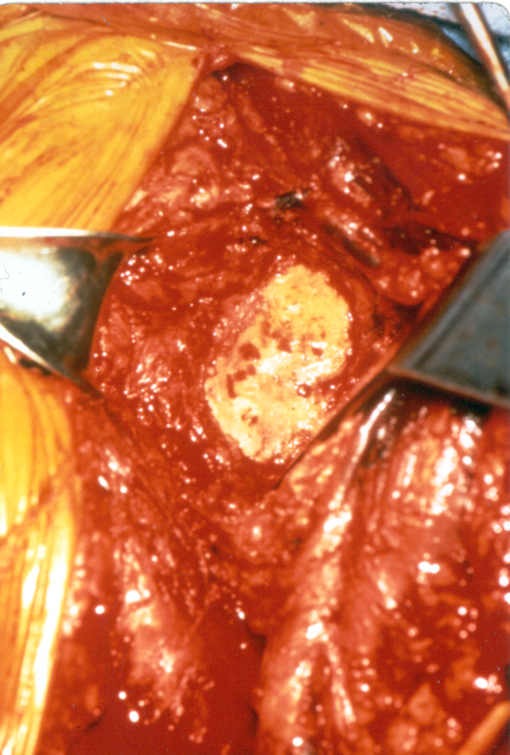
Shoulder Arthroplasty Glenoid Preparation
Release inferior capsule
Protect axillary nerve
Expose glenoid face
Assess posterior wear
Center starting hole
Bone graft as needed

Slide 37
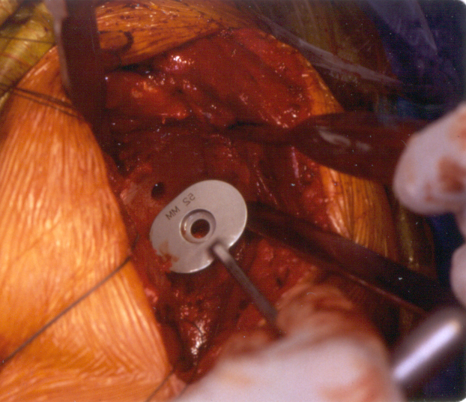
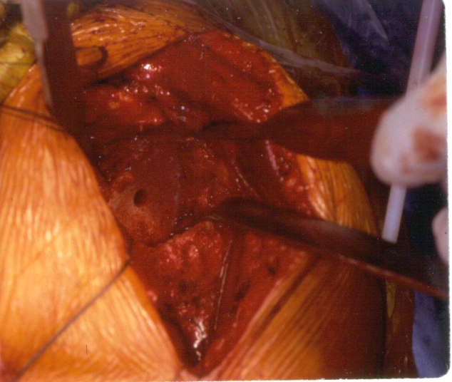
Shoulder Arthroplasty Glenoid Preparation

Slide 38
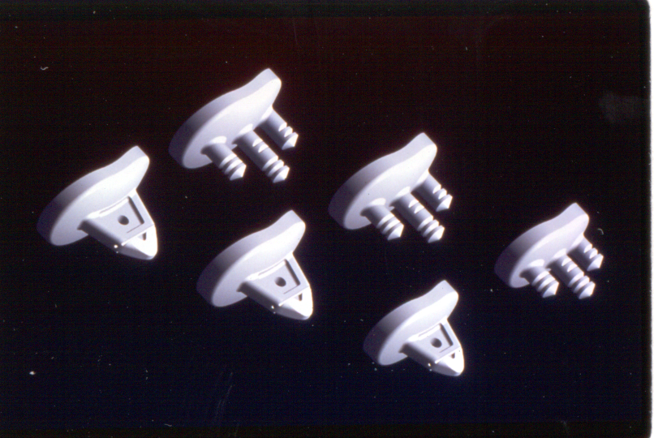
Shoulder Arthroplasty Glenoid Prosthesis
Keel
vs
Pegs

Slide 39
Top 8 TSA Myths
1. TSA is a new procedure
2. ROM does not improve after TSA
3. TSA has a high complication rate
4. TSA not as advanced as THA/TKA
5. TSA does not last long
6. TSA has high rate of glenoid loosening
7. HHA is as good as TSA
8. Pain relief is unreliable after TSA

Slide 40
Top 8 TSA Benefits
1. TSA is not a new procedure
2. ROM does improve after TSA
3. TSA does not have a high complication rate
4. TSA is as advanced as THA/TKA
5. TSA does last long
6. TSA does not have high rate of glenoid loosening
7. HHA is not as good as TSA
8. Pain relief is reliable after TSA

Slide 41
Pain Relief is Reliable After TSA
No. Avg F/U %G/E
(mos)
Neer 1982 40 39 100
Cofield 1984 77 46 92
Gristina 1987 100 38 90
Barrett 1987 50 42 88
Amstutz 1988 56 42 80
Hawkins 1989 70 48 91

Slide 42
Pain Relief is Reliable After TSA
No. Avg F/U %G/E
(mos)
Norris 1996 38 60 95
Gartsman 1997 70 41 91
Torchia 1997 35 146 71
Norris 2002 133 46 95
Edwards 2004 601 44 94
Levy 2004 42 91 90

Slide 43
ROM Does Improve After TSA
No. Avg F/U FE Gain
(mos.)
Neer 1982 40 39 N/A +77º
Cofield 1984 77 46 141º +55º
Barrett 1987 50 42 117º +44º
Amstutz 1988 56 42 120º +60º
Hawkins 1989 70 48 151º +77º

Slide 44
ROM Does Improve After TSA
No. Avg F/U FE Gain
(mos)
Norris 1996 38 60 124º +37º
Gartsman 1997 70 41 129º +47º
Torchia 1997 35 146 143º +47º
Norris 2002 133 46 138º +36º
Edwards 2004 601 44 145º +53º
Levy 2004 42 91 128º +66º

Slide 45
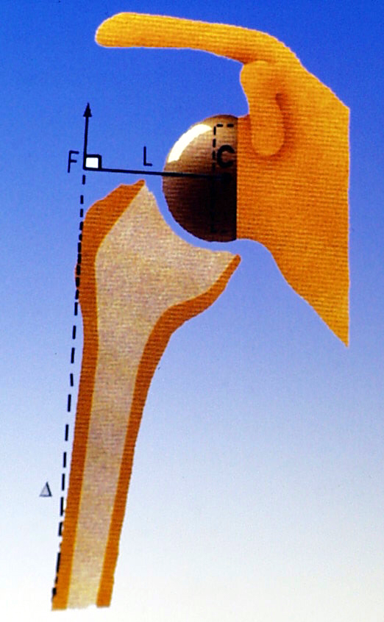
The Principles
Reverse Total Shoulder Arthroplasty-
Fixed center of rotation with congruent joint surfaces
- compensate for the deficient cuff muscles
- increase stability
Medialized center of rotation
- increase the deltoid lever arm
- reduce the torque on the
glenoid component
Lengthened humerus relative to the
glenoid
- to restore deltoid tension

Slide 46
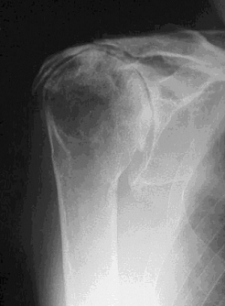
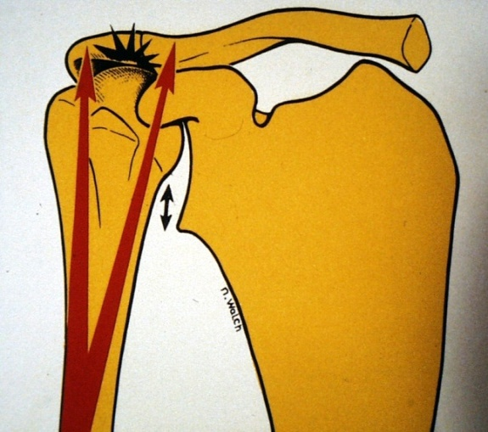
Rotator Cuff Deficiency
Force imbalance
Superior migration of humeral head
Unstable center of rotation

Slide 47
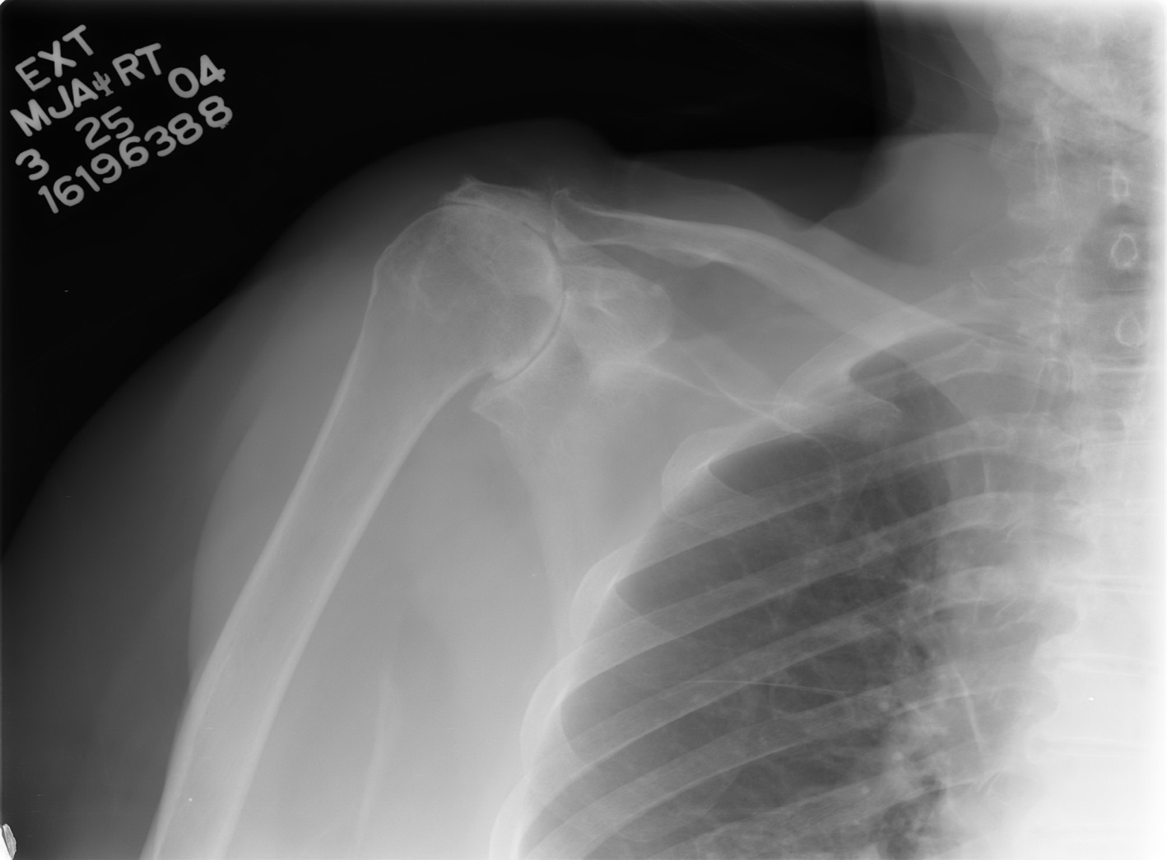
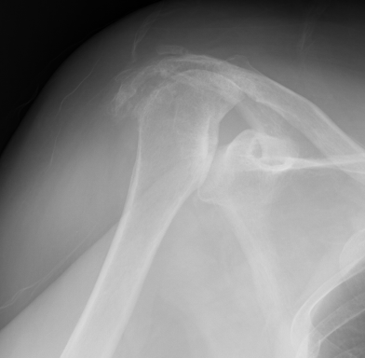
Cuff Tear Arthropathy: Radiographic Findings
Erosion (acetabularization) of the acromion
Superior glenohumeral subluxation
Femoralization
Collapse of humeral head
Glenohumeral degenerative changes

Slide 48
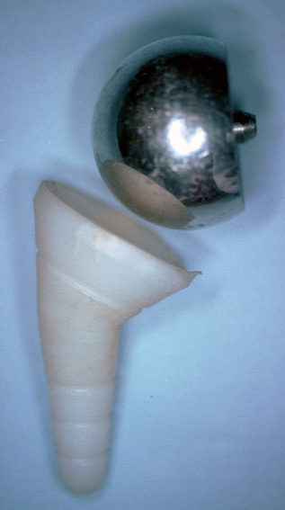
Modern Inverse Prosthesis (1985)
Paul Grammont
Two major innovations:
Glenoid sphere = a large ball & no neck
Humeral cup = inclination of 155°
(non anatomical)
Source: International Journal of Shoulder Surgery 2007, Volume 1, Issue 4; 108-113

Slide 49
Reversed Prosthesis
The Concept:
A prosthesis designed to:
function effectively with only the deltoid
be inherently stable
reduce the risk of glenoid loosening

Slide 50
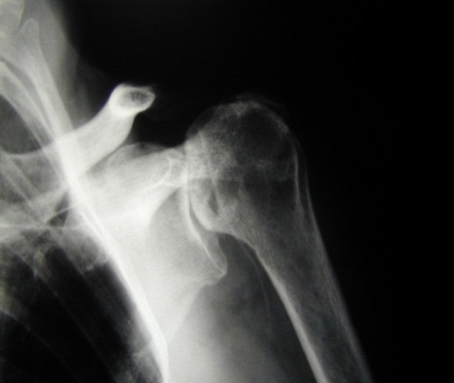
Reverse Ball-and-Socket Prosthesis
Introduced 1987 in France by Grammont and Baulot
DePuy Delta III prosthesis FDA approved in US 2004
Semiconstrained design
Restores glenohumeral fulcrum and deltoid mechanical advantage

Slide 51
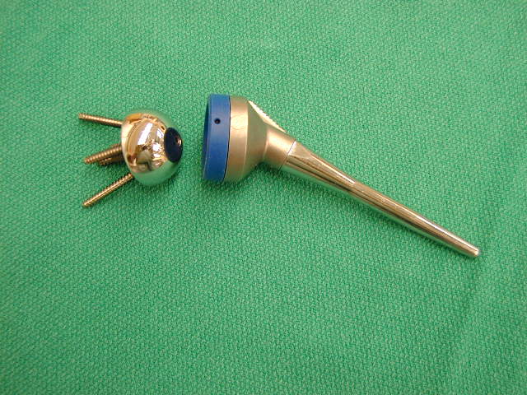
Reverse TSA
Humeral and scapular components are reversed
Concave polyethylene cup in proximal humerus
Glenoid sphere

Slide 52
Reverse Ball-and-Socket Biomechanics
Moves center of rotation medially and distally
Retensions the deltoid
Increases deltoid lever arm length
Compensates for cuff deficiency

Slide 53
Reverse TSA
Indication
Painful pseudoparalysis-inability to lift arm above horizontal
Due to
Rotator cuff arthropathy
Arthritis with massive irreparable RCT

Slide 54
Reverse TSA
Indication
Painful pseudoparalysis
Due to
Failed previous shoulder arthroplasty

Slide 55
Patient Selection: Considerations
Severity of pain
Poor function
Age
Activity level and ambulatory status
General health
Contralateral shoulder function
Patient expectations

Slide 56
Surgeon Considerations
Shoulder arthroplasty experience
Knowledge of indications
Hemi vs. RTSA
Comfortable with glenoid exposure
Not for hemiarthroplasty surgeon
Complications
Understand causes
How to treat

Slide 57
Reverse TSA 80 yo F- B Irreparable RCT; Painful Pseudoparalysis

Slide 58
Reverse TSA 77 yo female with CTA- Pre-Op

Slide 59
Reverse TSA 77 yo female with CTA- Post-Op

Slide 60
Reverse TSA
Good European experience
Grammont PM, Orthopedics, 1993
Rittmeister M, JSES, 2001
Boulahia A, Orthopedics, 2002
Gerber C, JBJS-A, 2005
Good pain relief
Significant improvement in aFE
Longest term data available is 15 yr French multicenter study
Longevity of implants not clearly known yet

Slide 61
Physical Therapy after Shoulder Replacement
Shoulder PROM / pendulums and Elbow, wrist, hand ROM POD 1
Discharge POD 2-3
Protect subscapularis repair!!
Anterior dislocation s/p TSA

Slide 62
Shoulder Arthroplasty Rehabilitation
Start outpatient PT at 2 weeks
PROM / AAROM
Protect subscapularis repair / lesser tuberosity osteotomy
Avoid ER past neutral for 6 weeks
Avoid resisted IR
NWB
Able to do ADL’s in 1-2 weeks

Slide 63
Shoulder Arthroplasty Rehabilitation
Phase I
PROM/AAROM
Phase II
AROM
Phase III
Strengthening
Hughes MA, Neer CS, Phys Ther, 1975

Slide 64
Physical Therapy after Shoulder Replacement
NWB operated limb
No lifting, carrying, pushing, pulling heavier than a glass of water
Sling for 4-6 wks
No driving until out of sling and off pain meds

Slide 65
Reverse TSA Rehabilitation
NWB, sling x 4-6 wks
Elbow, wrist, digit ROM POD 1
Shoulder exercises at 2 wks
Encourage ADLs

Slide 66
Reverse TSA Rehabilitation
May experience loss of ER strength
Medialization of center of rotation effectively shortens external rotators
Arm may be held in slight abduction
Due to deltoid tension
No mobilizations
Semiconstrained device
Increased risk of dislocation

Slide 67
Conclusions
Total shoulder arthroplasty is effective for pain relief and functional improvement in patients with shoulder arthritis due to a variety of causes.
Reverse shoulder replacement offers a promising solution for patients with difficult shoulder problems, for whom no satisfactory solution was previously available. Long term data is still being collected.

Slide 68
Thank You

